Slide 1
FACILITIES PLANNING Condition, Maintenance, and Capacity Scott Landrigan 03-24-21

Slide 2
Facilities Planning CES, NFES, WMS, WHS, YALE, WSD
Historical mapping
School statistics
Roofing plan
Blacktop plan
Utility Overview
Water
Fire systems
Electrical distribution
Natural gas
HVAC overview and needed improvements
Structural and interior finishes
Plumbing plan
Portable building plan
10 year cost summary by school
Fleet vehicles and grounds equipment
Preliminary seismic report
10 year District financial impact report

Slide 3
WSD Facilities Plan Introduction
This presentation is based on a 10 year plan ending Spring 2031.
Costs are based on today’s rate, expect a 2% to 3 % increase per year.
It will become clear that all items listed can not be addressed, due to budget constraints.
Items will be prioritized based on the following criteria:
Safety, health, and environmental
Compliance to law
Quality of instruction
Asset protection
Asset replacement
Alternate methods for cost reduction will be provided for:
Alternate materials
Value engineering
In-house completion of projects
Each campus will be discussed independently and a final District summary will be given

Slide 4
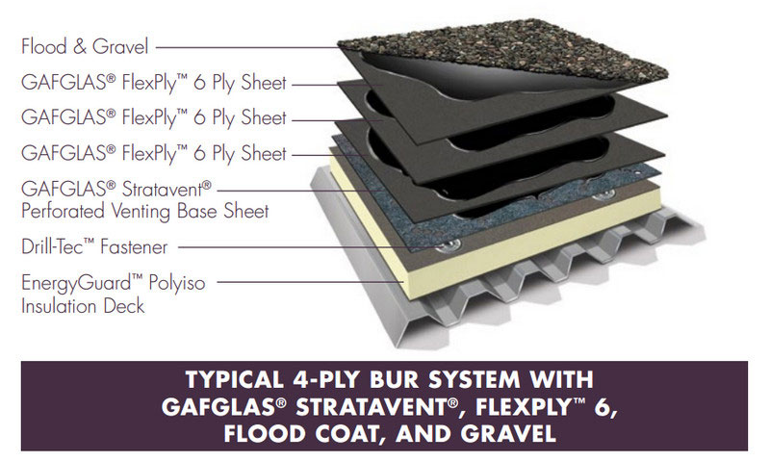
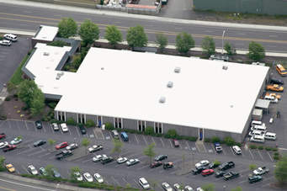
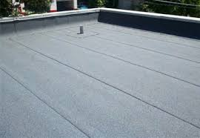
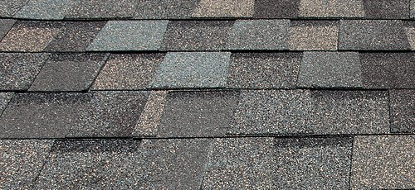
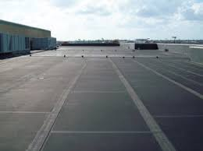
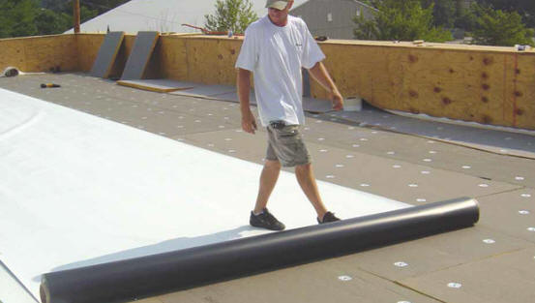
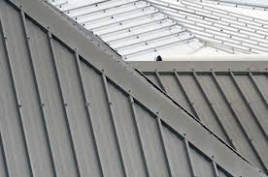
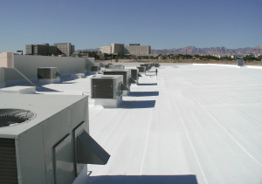
Roofing Roofing Types
PITCHED ROOFS
Composition 3 tab
PVC
Poly vinyl chloride
(Heat-welded seams)
FLAT OR ROOFS
WITH LOW PITCH
Built up with composition roll cap
Composition
Architectural
Roof Coatings
Silicone-based
GE Enduris 3500
TPO
Thermoplastic Polyolefin
Plastic/rubber with filler
(Heat-welded seams)
EPDM Ethylene Propylene
Diene Monomer
(Glued seams)
Metal

Slide 5
Roofing Info Cost and Pricing Variables
Pricing considerations that influence total cost
Number of roof layers
Stripping off old roof vs. cover
Decking and structural repairs
Insulation requirements type/location
Material type (cap)
Asbestos mitigation
Roof penetrations
Compliance to energy codes
Warranty
Cost of delaying
Mold
Compromised decking
Structural Failure
For this presentation the following
standard costs will be used
All sloped comp roofs $5.00 sqft.
Flat roofs @ $7.00 sqft.
Metal roofs @ $10.50 sqft.
Roof coatings @ $2.25 sqft.

Slide 6
Columbia Elementary School
Home of Kit the Beaver

Slide 7
Columbia Elementary School School Statistics
Site 7.91 acres (1 lot)
Building area 1.30 acres
Field adjacent to school 1.44 acres (2 lots)
Original construction 1971-72,
42,743 sqft. (As Middle School)
Addition 1992-93 adds 13,643 sqft. (current kinder and 1st grade wing)
Total building sq. ft. 56,386
Classrooms 21(2) excludes portables
11 Classrooms upper or original construction
10 classrooms lower wing
2 art/music studios (locker room conversion) expected to provide expansion space for 1 year
Parking 83 spaces, 3 ADA, no designated bus parking
73 staff and 331 students

Slide 8
CES Historical Look
1992 Addition Adds 10
classrooms
COOP
(NDA)
P11/12
COOP
ECAP
Lower wing
kinder and 1st grade
EOCF
HEAD
START
(NDA)
P8/9
FCRC
1982 Locker room expansion, covered play area
P6/7
Special Ed
Pre School
ART/MUSIC
P5 Comp Lab
P4 SPED
CVR
PLAY
GYM
Upper wing
2nd through
4th grade
1972 Initial
construction
11 classrooms,
gym, music
café
P2/3
WCC

Slide 9
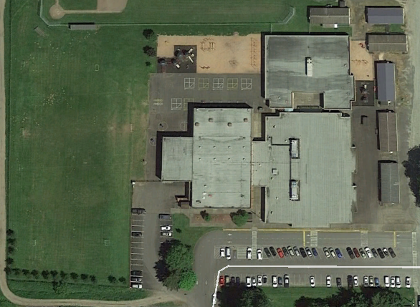
CES Roofing and Blacktop Plan
4
A
Roofing
1 Covered play structure
2 Gym, café & mezzanine
3 1st grade wing
4 K-wing
Blacktop
A Recess area
B West lot parking
C Main parking lot (south)
D Portable aprons
1
2
3
D
B
C

Slide 10
CES
Roofing Analysis
Name /Area | Sqft. | Current Type | Grade | Remaining Life | Cost of Repair | Note
Covered play area (1) | 3,500 | Built up Comp. cap | D | 2026 | $24,500 | Full rip off, TPO recover
Gym/cafeteria (2) | 15,650 | Built up Comp. cap | D | Coat 2022 | $35,212 | Excellent coating candidate
Upper Wing (3) (original construction) | 25,380 | Built up Comp. cap | C | Coat 2024 | $57,105 | Excellent coating candidate
Lower Wing (4) | 16,250 | Built up Comp cap | C | Coat 2028 | $36,562 | Excellent coating candidate
A | New condition | B | Near new condition 75% | C | Mid life span 50% | D | Moderate repairs 25% | F | Imminent failure, replace

Slide 11
CES
Blacktop Analysis
Name /Area | Sqft. | Current Type | Grade | Cost of Repair Sqft. | Extend Cost | Note
Playground area (A) | 22,000 | Blacktop | C | .36 | $7,920 | Sealcoat 2022/2029
West parking (B) | 11,000 | Blacktop | B | .36 | $3,960 | Sealcoat/stripe/repair 2023/2030
Main parking lot (C) | 34,000 | Blacktop | D | .36 | $12,240 | Sealcoat/stripe/repair 2021/2028
Portable approach (D) | 10,500 | Blacktop | C | .36 | $3,780 | Seal coat/stripe/repair 2022/2029
A | New condition | B | Near new condition slight but even wear | C | Worn light cracking | D | Course W/multiple cracks water damage | F | Imminent failure, replace

Slide 12
CES Flooring
Room Area | Material | Condition | RPL Cost | Room Area | Material | Condition | RPL Cost | Room Area | Materal | Condition | RPL Cost
Old music | VCT | A >10 year |  | 103 | Carpet | A >10 year |  | 204 | VCT/Carpet | A/C 25/29 | 6,000
Cafe | VCT | D 22-25 | 3,500 | 104 | Carpet | A >10 year |  | 206 | VCT/Carpet | A/A >10 yr.
Gym | Plastic | A >10 year |  | 105 | Carpet | A >10 year |  | 207 | VCT/Carpet | A/C 25/29 | 6,000
Kitchen | Rubber | B ≥ 10 Years |  | 106 | Carpet | A >10 year |  | 208 | VCT/Carpet | A/C 25/29 | 6,000
Art/music | Carpet | F - Schedule | 6,000 | 107 | Carpet | A >10 year |  | 209 | VCT/Carpet | A/C >26
Lobby | WOM | A >10 year |  | 108 | Carpet | A >10 year |  | 210 | VCT/Carpet | A/D >26
Office | Carpet | A >10 year |  | 109 | Carpet | A >10 year |  | 211 | VCT/Carpet | A/A >10 yr.
Library | Carpet | A >10 year |  | 110 | Carpet | A >10 year |  | 212 | VCT/Carpet | A/C 25-29 | 6,000
101 | Carpet | A >10 year |  | 111 | Carpet | A >10 year |  | 213 | VCT/Carpet | A/C 25-29 | 6,000
102 | Carpet | A >10 year |  | Office | Carpet | A >10 year |  | Hall | VCT | B ≥ 10 Years
PD Rm | Carpet | B ≥ 10 Years |  | 203 | VCT Carpet | A/C 25/29 | 6,000 | Comm | Carpet | A >10 year
A | New or like new > 10 years Life | B | Slight wear replace estimated ≥ 10 Years | C | Worn evenly no damage replace estimated 25-29 | D | Perm. stain, minor damage or seam damage replace estimated 22-25 | F | Extensive damage replace at earliest opportunity

Slide 13
CES HVAC
Conference room electric A/C roof top package unit. Replacement needed 35+ years old for $15,000.
Two 40 ton gas electric air handling rooftop units, 25+ years old, near the end of normal service life, but still in good operating condition. Estimated cost to upgrade $150,000.
Lower wing air handler A/C system with individual room VAV units, with resistance electric heaters. 25+ years, near end of normal service life, but still in good operating condition.
Gym side of building had new boilers installed in 2013. Boilers are connected to the original 1970’s air handling units. The original air handling units should continue to be serviced and repaired with no complete replacements needed within 10 years.
Roof exhaust fans, welded seams failing on numerous locations, will replace with roof work for $7,500.
Entire school had a HVAC control system upgrade 9 years ago by NCC.
Art/Music room, install split systems at $7500 each.

Slide 14
CES Structural and Exterior/Interior Finishes
Wood stringers in parapet, selective replacement with T1-11 siding for $8,500 – 2023
Replace ceiling tiles in selective areas damaged by roof leaks for $7500 – 2021 (safety)
Entire exterior of campus painted 2016/2017 EST 2026 paint for $7,500

Slide 15
CES Utilities
Water /Plumbing
Dedicated filter drinking water line installed - 2020
Replace balance of galvanized piping 1st grade wing $35,000 -2023/24. 2/3’s currently complete.
Fire Systems
Original construction no fire sprinklers $150,000 – grant candidate
K-wing full sprinklers
Electrical
Panel locks/covers and remote switching for $3,500 - 2021
Switchboard, panel labeling and schedules for $2,500 - 2021
Switchboard and panel cleaning/ torqueing/lubrication and testing for $2,500 - 2021
Natural Gas
Leak detect, isolation boiler room for $8,500 - 2021

Slide 16
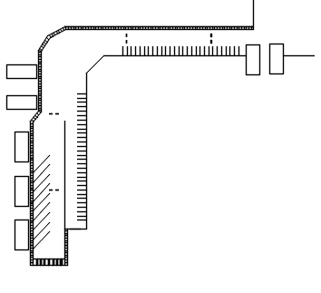
CES Grounds Overview
Bus, Bike, Student and Pedestrian
Safety Corridor
Install 900 linear feet sidewalk
40,000 sq. ft. blacktop
Install speed bumps
Bus parking area
60 parking stalls
2 pedestrian crosswalks
Designated bike lane
**Estimated $250,000
Trying to acquiring grants
** Not in school cost sheet, preliminary cost estimate,
not hard quoted

Slide 17
CES Portable Buildings
2021 | 2022 | 2023 | 2024 | 2025 | 2026
$8,500 |  | $8,000 | $9,000 | $6,000
Port. Bldg. | Use | Roof | Siding | Ramps | Flooring | Interior Finishes | Ext Paint | Restrooms
PO 2/3 | WCC | 3 tab RPL 2021 8,500 | A | 2023 $5,000 | 2024 $6,000 | 2024 $3,000 | New | Existing
PO 4/5 | DSP Comp lab | 3 tab | A | New | P4- New P5-Carpet C | P-4 new P-5 | New | Installed 2019
PO 6/7 | SPED Preschool | Metal | A | New | New | New | New | Existing
PO 8/9 | FCRC | 3 tab New | A | New | 2025 $6,000 | 2023 $3,000 | New | Existing
PO 11/12 | CO-OP ECAP | Metal | A | New | New | New | New | Installed 2018
PO 10 Non-district | ECAP Head start | - | - | - | - | - | - | -
PO 14 Non-district | CO-OP Preschool | - | - | - | - | - | - | -
Total |  | $8,500 |  | $5,000 | $12,000 | $6,000

Slide 18
CES 120 month Facilities plan
 | 2021 | 2022 | 2023 | 2024 | 2025 | 2026 | 2027 | 2028 | 2029 | 2030 | 2031
Roof |  | $35,212 |  | $57,105 |  | $24,500 |  | $36,562
Blacktop | $12,240 | $11,700 | $3,960 |  |  |  |  | $12,240 | $11,700 | $3,960
Flooring | $6,000 | $3,500 |  |  | $11,000 | $6,000 | $6,000 | $6,000 | $6,000
HVAC
Structural/Ext | $7,500 |  | $8,500 |  |  | $7,500
Utilities | $8,500 | $8,500 | $17,500 | $17,500
**Grounds
Portables | $8,500 |  | $8,000 | $9,000 | $6,000
Total WPS | $42,740 | $58,912 | $37,960 | $83,605 | $17,000 | $38,000 | $6,000 | $54,802 | $17,700 | $3,960

Slide 19
North Fork Elementary School
Home of the
Eagles

Slide 20
North Fork Elementary School School Statistics
Site 10.68 acres (3 lots)
Building footprint approximately 1 acre (.97)
Main school parcel 218,671 sqft. (5.02 acres)
Sports field 236,095 sqft. (5.41 acres)
Acquired property 10,000 sqft. (.25 acres)
Original construction 1997/1998
Classrooms
21 classrooms
1 Resource room
1 Special Education room (classroom)
1 Computer lab
1 Music room
6 portable classrooms
Parking - 91 car, 5 ADA, 15 Bus
417 students and 78 staff

Slide 21
NFES Historical Look
1997/1998
Initial construction
Third Portable
Added 2019
Two Portables
Installed August 2017

Slide 22
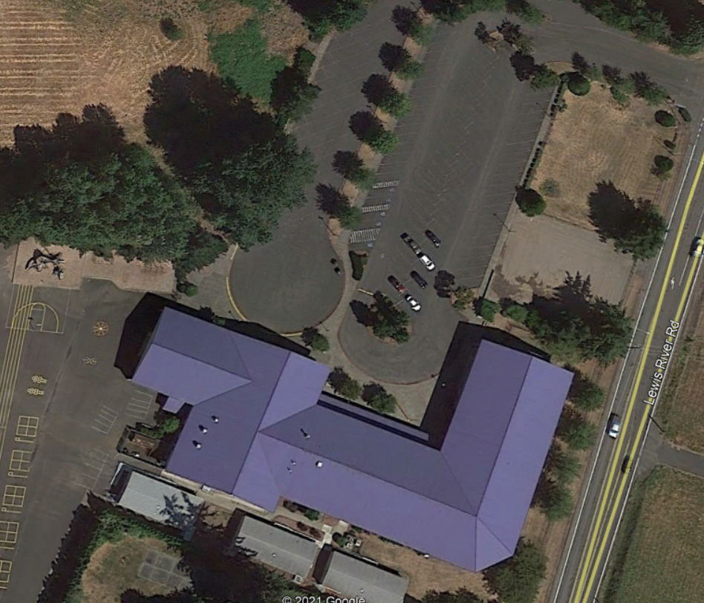
NFES Roofing and Blacktop Plan
A
A
NFES ROOFING MAP
Covered play area
Gym
Classroom wing (west)
Classroom wing (north)
Entry canopy
BLACKTOP MAP
A Bus/main parking lot
B Playground/walking path
C Vacant lot for expansion
A
C
A
B
B
1
2
5
4
3

Slide 23
NFES Roofing
Name /Area | Sqft. | Current Type | Grade | Remaining life | Replace Cost | Notes
Covered Play Area (1) | 4,764 | Metal | B | >10 years | N/A
Gym (2) | 12,870 | Metal | B | >10 years | N/A
Classroom Wing South (3) | 10,472 | Metal | B | >10 years | N/A
Classroom Wing North (4) | 16,588 | Metal | B | >10 years | N/A
Entrance Awning (5) | 1,501 | Metal | B | >10 years | N/A

Slide 24
NFES Blacktop Analysis
A | New condition | B | Near new condition slight but even wear | C | Worn light cracking | D | Course W/multiple cracks/ water damage | F | Imminent failure, replace
Name /Area | Sq/ft | Current Type | Grade | Cost of Repair sqft | Extended Cost | Note
Main parking lot (A) | 63,500 | Blacktop | B | .36 | $22,860 | Sealcoat /stripe/repair 2023/2029
Playground (B) | 46,500 | Blacktop | D | .36 | $16,740 | Sealcoat 2022/2030

Slide 25
NFES Flooring
Room Area | Material | Condition | RPL < | Room Area | Material | Condition | RPL Cost | Room Area | Material | Condition | RPL Cost
Kitchen | Tile | A | >10 year | 103 | Carpet | B | ≥ 10 Years | 205 | Carpet | C | 25-29
Gym | Plastic | B | ≥ 10 Years | 104 | Carpet | C | 25-29 | 206 | Carpet | C | 25-29
Restrooms | Tile | A | >10 year | 105 | Carpet | C | 25-29 | 207 | Carpet | C | 25-29
Music | Carpet | D | 22-25 | 106 | Carpet | C | 25-29 | 208 | Carpet | B | ≥ 10 Years
Hallway | VCT Tile | B | ≥ 10 Years | 107 | Carpet | B | ≥ 10 Years | 210 | Carpet | A | >10 year
SPED | Carpet | C | 25-29 | 109 | Carpet | B | ≥ 10 Years | 211 | Carpet | A | >10 year
Sm OFF | Carpet | B | ≥ 10 Years | 113 | Carpet | C | 25-29 | 212 | Carpet | C | 25-29
Staff BRK | Carpet | C | 25-29 | 200 | Carpet | D | 22-25 | 213 | Carpet | C | 25-29
Comp Lab | Carpet | C | 25-29 | 201 | Carpet | A | >10 year | 214 | Carpet | C | 25-29
M Office | Carpet | B | ≥ 10 Years | 209 | Carpet | C | 25-29
Library | Carpet | C | 25-29 | 202 | Carpet | B | ≥ 10 Years
101 | Carpet | B | ≥ 10 Years | 203 | Carpet | B | ≥ 10 Years
102 | Carpet | B | ≥ 10 Years | 204 | Carpet | C | 25-29
A | New or like new > 10 years Life | B | Slight wear replace estimated ≥ 10 Years | C | Worn evenly no damage replace estimated 25-29 | D | Perm. stain, minor de-lamination or seam damage replace estimated 22-25 | F | Extensive damage replace at earliest opportunity

Slide 26
NFES HVAC
HVAC local control modules are obsolete new replacements are $1,900 each. Total estimated at 60K. These can be replaced as they fail when the new server is installed.
This is a two story school without A/C in the classrooms. The school gets uncomfortably hot in the early and late part of the school year. The current boilers and air handling units are original to the school and are nearing the end of the normal service life.
It’s recommended to replace the boilers, air handling units and add a chiller for building air conditioning.
Estimated cost for entire HVAC system upgrade 1.6 million. Expected to be part of new future school bond. Temporary portable AC units are being used.

Slide 27
NFES Structural and Exterior Finishes
Masonry block and stucco.
No major cost expected next 10 years.

Slide 28
NFES Utility Overview
Water /plumbing
Install filtered PEX drinking water line started 2020. $3,500 in progress
Fire Systems
Wet/Dry full building
On routine testing cycle
Electrical
All panels appropriately secured
Panel schedules in place
Switchboard cleaning/lubrication/inspection $2500 2022
Gas
Kitchen equipment
4 hot water boilers
2 commercial hot water heaters
1 Reznor MAU (kitchen MAU)

Slide 29
NFES Grounds
Irrigation tank and distribution – $15,000, 2022
Remove trees
Repair walking path – $3,500, 2021

Slide 30
NFES Portables
2021 | 2022 | 2023 | 2024 | 2025 | 2026 | 2027 | 2028 | 2029 | 2030 | 2031
 |  |  | $5,000 |  | $2500
Portables | Use | Roof | Siding | Ramps | Flooring | Interior Finishes | Ext Paint | Restroom
PO 1/2 | BOOST | 3 tab >10 year | A | New-Alum | New 2017 >10 year | >10 year | 2024 $2500 | Installed
PO 3/4 | Classroom Classroom | 3 tab >10 year | A | New-Alum | New 2017 >10 year | >10 year | 2024 $2500 | Installed
PO 5/6 | Classroom Classroom | 3 tab >10 year | A | New- Alum | New 2019 >10 year | >10 year | 2026 $2500 | Installed
Total |  |  |  |  |  |  | $7,500

Slide 31
NFES 120 month maintenance plan
6 month | 2021 | 2022 | 2023 | 2024 | 2025 | 2026 | 2027 | 2028 | 2029 | 2030 | 2031
Roof
Blacktop |  | $16,740 |  |  | $22,860 |  | $16,740 |  |  | $22,860
Flooring |  | $6,000 | $12,000 | $12,000 | $12,000 | $12,000 | $12,000 | $12,000 | $12,000
HVAC
Structural /Exterior
Utilities | $3,500 | $2,500
Grounds | $3,500 | $15,000
Portables |  |  |  | $2,500 |  | $2,500
Total NFES | $7,000 | $40,240 | $12,000 | $14,500 | $34,860 | $14,500 | $28,740 | $12,000 | $12,000 | $22,860

Slide 32
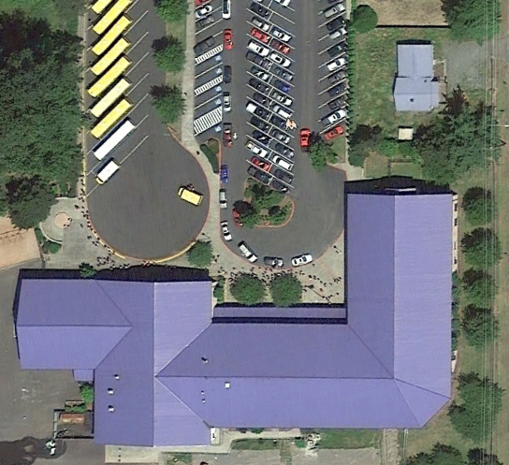
NFES Expansion of Parking Lot
Acquired property
2280 Lewis River Road, directly
to the north of the school north wing
House demolished in December 2017
Property sqft. 11,000 (.3 acre)
Space could provide an additional 30
needed parking spaces

Slide 33
Woodland Middle School
Home of the Trojans

Slide 34
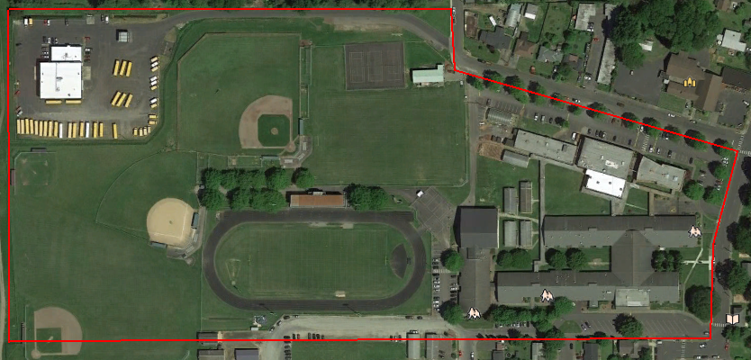
WMS School Statistics
Site 33.46 acres 2 parcels
Buildings 3.02 acres
Original construction (current site layout)
1951/1953/1962/1964/1966/1967/1982/1993
Classrooms 33 (excluding CTE wing)
Gross sq. ft. 132,000
Parking 138 auto, 5 ADA 18 bus
649 students and 74 staff

Slide 35
WMS Historical Look
Originally constructed as Primary School in 1951
Commons and classroom addition 1953/54 as part of WHS construction
Yellow hall addition 1962
Green hall extension 1964
Classroom addition (2) 1967
Gym locker room 1982
Yellow gym, library addition and building modernization 1993
5 portable buildings

Slide 36
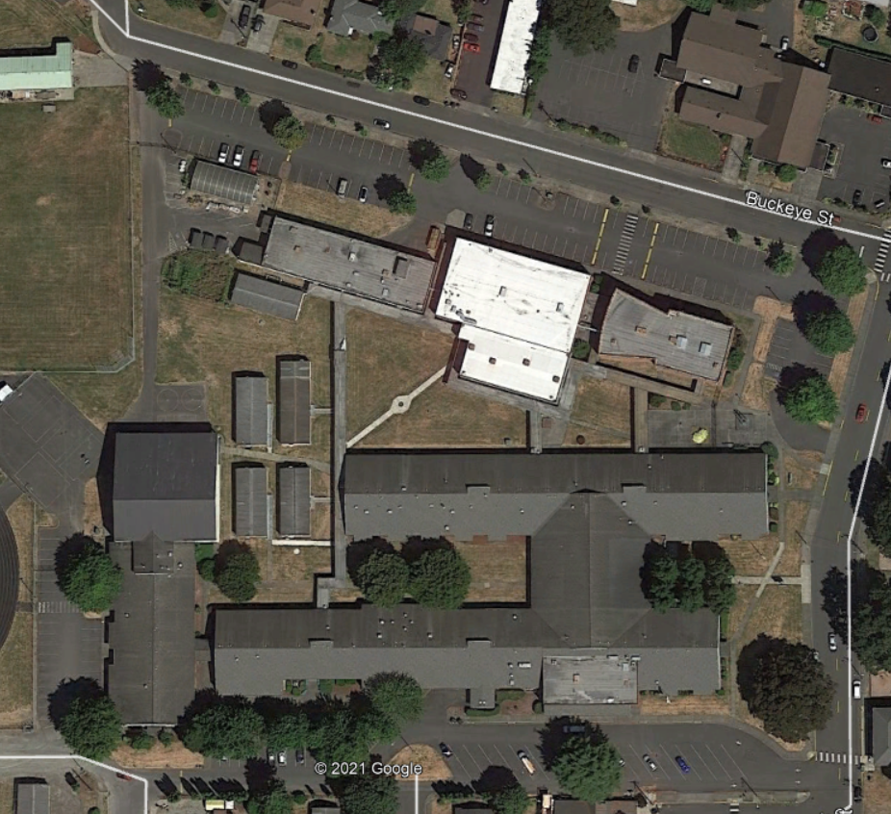
WMS Roofing Map
WMS ROOFING MAP
Yellow Gym
Yellow Hall west
Yellow Hall main
Commons
Library bridge
Green Hall
Metal Shop
Green Gym
Green Mezzanine
Performing Arts
BLACKTOP
A North/Green Gym parking
B West parking, BB court, service road
C Bus parking, DO, south
A
7
8
10
9
B
1
6
5
2
3
4
1
1
C

Slide 37
WMS Roofing Analysis
Name /Area | Sq/ft | Type | Grade | Replace-ment | Cost | Note
Yellow Gym (1) | 10,780 | Metal | C | >10 years | -
Yellow Hall west end (2) | 15,325 | Composition S | A/C | 2025 | $34,481
Yellow Hall main (3) | 37,571 | Composition S | A/C | 2027 | $84,535
Commons (4) | 3,950 | Comp B/U | D- | 2021 | $8,887 | Silicone coating
Library (5) | 8,950 | Composition S | A/C | >10/2028 | $20,137
Green Hall (6) | 36,050 | Composition S | A/C | >10/2029 | $81,112
Metal Shop (7) | 7,700 | Comp B/U | D | 2021 | $17,325 | Silicone coating
Green Gym (8) | 10,150 | TPO | A | >10 years
Green Mezz (9) | 5,000 | TPO | A | >10 years | -
Performing Arts (10) | 6,720 | Comp B/U | D | 2021 | $15,120 | Silicone coating

Slide 38
WMS Blacktop Analysis
Name /Area | Sqft. | Current Type | Grade | Cost Sqft. | Extended Cost | Note
North parking lot (A) | 51,500 | Blacktop | C | .36 | $18,540 | Sealcoat/stripe/repaired 2022/2029
Playground, west parking, service rd. (B) | 33,000 | Blacktop | B | .36 | $11,880 | Sealcoat/stripe/repaired 2024/2031
Commons and DO Parking (C) | 36,530 | Blacktop | B | .36 | $13,150 | Sealcoat/stripe/repaired 2026
A | New condition | B | Near new condition slight but even wear | C | Worn light cracking | D | Course W/multiple cracks water damage | F | Imminent Failure, replace

Slide 39
WMS Flooring
A | New or like new > 10 years Life | B | Slight wear replace estimated ≥ 10 Years | C | Worn evenly no damage replace estimated 25-29 | D | Perm. stain, minor de-lamination or seam damage replace estimated 22-25 | F | Extensive damage replace at earliest opportunity
Yellow West |  |  |  | Yellow East |  |  |  | Green Hall
Room/Area | Material | Cond. | REPL | Rm/Area | Material | Cond |  | Room/Area | Material | Cond | Condition
313 | Carpet new | A | >10 year | 449 | Carpet new | A | >10 yr. | 413 | Carpet new | A | >10 year
325 | Carpet new | A | >10 year | 450 | Carpet new | A | >10 yr. | 415 | Carpet new | A | >10 year
LRA | Carpet tiles | A | ≥ 10 Years | 317 | Carpet new | A | >10 yr. | WMS Office | Carpet tiles | B | ≥ 10 Years
Lkr Room | Epoxy | B | ≥ 10 Years | 314 | Carpet new | A | >10 yr. | 421 | Carpet new | A | >10 year
307 | Carpet new | A | >10 year | 323 | Carpet old | B | ≥ 10 Years | 423 | Carpet new | A | >10 year
308 | Carpet new | A | >10 year | 326 | Carpet old | D | 22-25 | 427 | Carpet new | A | >10 year
305 | Carpet new | A | >10 year | 447 | Carpet new | A | >10 years | 429 | Carpet new | A | >10 year
306 | Carpet new | A | >10 year | 448 | Carpet old | C | 25-29 | 412 | Carpet new | A | >10 year
311 | Carpet old | D | 22-25 | 319 | Carpet old | D | 22-25 | 417 | Carpet new | A | >10 year
312 | Carpet old | D | 22-25 | 320 | Carpet old | B | ≥ 10 Years | 424 | Carpet old | B | ≥ 10 Years
DO | Carpet new | A | >10 year | Kitchen | Epoxy, new | A | >10 Years | 425 | Carpet old | B | ≥ 10 Years
Main hall | Carpet old | B | ≥ 10 Years | 318 | VCT tile | B | ≥ 10 Years | 419 | Epoxy | B | 25-29
324 | Carpet old | F | Replace | Commons | VCT tile | B | ≥ 10 Years | 428 | VCT tile | A | >10 year
Gym hall | VCT tile | B | ≥ 10 Years | S. Commons | VCT tile | B | ≥ 10 Years | 426 | VCT tile | A | >10 year
Bathrooms | Tile | A | >10 | Comm hallway | VCT tile | B | ≥ 10 Years | 430 | VCT tile | B | ≥ 10 Years
315 | VCT tile | B | ≥ 10 Years | Gym | Wood | B | ≥ 10 Years | 431 | VCT tile | B | ≥ 10 Years
316 | VCT tile | B | ≥ 10 Years | Library | Carpet new | A | >10 yr. | 432 | VCT tile | A | >10 year
Yellow Gym | Wood | B | ≥ 10 Years | Yellow hall | Carpet | C | 25-29 | Green hall | VCT tile | A/C/B | Var

Slide 40
WMS HVAC
Computer server room A/C unit. The current A/C system is 23+ years old and is too small for the amount of heat generated by the number of installed computer equipment. Needs new larger system. Recommend adding a ductless A/C split system for 10K.
LRA, District Office, Middle School Office, computer lab and science classrooms all have split heat pump units with air handlers that are beyond their normal service life 23+ years old, these will need to be replaced over the next 10 years as parts become unavailable. Estimated cost is 150K.
Classroom furnaces. Each classroom and common hallway areas are heated by a residential style gas furnace. These gas furnaces are 23+ years old and many of the parts are no longer available. Furnaces will need to be replaced when parts fail. Estimated cost per furnace to replace is 5K.
Gym and auditorium had new boilers installed 2019. These boilers are connected to old air handling units that should continue to be serviced and repaired with no replacements needed anytime soon.
Entire school had a HVAC control system upgrade 9 years ago.

Slide 41
WMS Structural Interior and Exterior Finishes
Exterior painting and sealing for $7,500 in 2019-2022 (in house cost, in progress)
Ceiling tiles in green gym (safety concern) for $8500 in 2021
Floor leveling and coating in covered lunch area for $8500 in 2023
Enclosed pass through hallway in the green/yellow halls for $25,000 in 2023

Slide 42
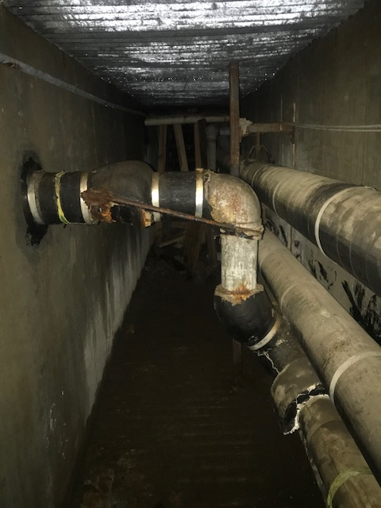
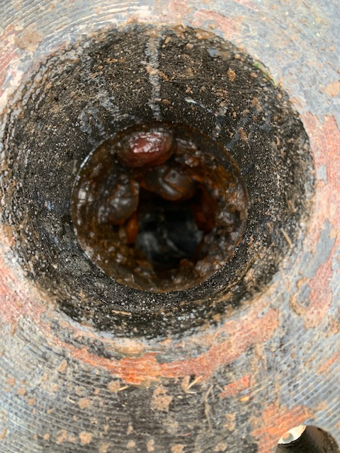
WMS Utility Overview
Water
Replaced galvanized lines to CTE complex in 2022 (service life expired) for $12,000
Install dedicated fountain service line. Completed in 2021 for $7,500
Electrical
Install exterior LED lighting in covered play area for $3,500 in 2022
Complete main switchboard maintenance for $2500 in 2023
Repair broken panels and add exterior switching for $3,500 in 2021
GAS
Install gas leak detection and isolation system for $15,000 in 2021
Fire safety
Clean up/map Simplex wiring for $5,000 in 2023
22

Slide 43
WMS Grounds
Item | Cost | When
Remove balance of pin oaks install new trees Buckeye St – undermining sidewalk and blacktop |  | Completed 2020
Building gutter replacement (in progress) | $17,325 | 2021
Well distribution storage tanks and distribution | $7,500 | 2022
Drywell drain line clearing | $4,500 | 2022
Covered walkway gutter replacement | $17,100 | 2024

Slide 44
WMS Portable Buildings
Port. Bldg. | Use | Roof | Side | Ramp | Flooring | Interior Finishes | Restroom | Cost /Notes
462 463 | FAC/Train ELL | C 2030 | New 2017 | New 2017 | New A New A | B B | No No | Roof 2030-$8,000
464 465 | GRN Rm Storage | D 2026 | New 2017 | New 2017 | VCT D VCT D | C C | No No | Flooring 2024-$7,000 Roof 2026-$8,000 Interior 2023-$3,000
466 467 | Training SS | C 2029 | New 2017 | New 2017 | Carpet C Carpet C | C C | No No | flooring 2025-$7,000 Roof, 2026 -$8,000
468 469 | Music Testing | C 2029 | New 2017 | New 2017 | Carpet D Carpet B | B B | No No | Flooring 2029 – $7,000 Roof 2027 – $8,000
470 471 | Comp lab Comp lab | D 2026 | New 2017 | Replace | Carpet B Carpet B | B B | No No | Ramp 2022-$5,000 Carpet 2023-$7,000 Roof 2028 -$8,000
462

Slide 45
WMS 120 month maintenance plan
6 month | 2021 | 2022 | 2023 | 2024 | 2025 | 2026 | 2027 | 2028 | 2029 | 2030 | 2031
Roof | $41,332 |  |  |  | $34,481 |  | $84,575 | $20,137 |  | $81,112
Blacktop |  | $18,540 |  | $11,880 |  | 13,150 |  |  | $18,540 |  | $11,880
Flooring | $12,000 |  | $12,000 |  | $6,000 | $6,000 | $6,000 | $6,000
HVAC |  | $10,000 | $15,000 | $50,000 | $15,000 | $50,000 | $15,000 | $50,000 | $15,000 |  | $50,000
Structural /Exterior | $16,000 | $7,500 | $33,500
Utilities | $26,000 | $14,500 | $5,000
Grounds | $17,325 | $12,000 |  | $17,100
Portables |  | $5,000 | $10,000 | $7,000 | $7,000 | $16,000 | $8,000 | $8,000 | $7,000 | $8,000
Total WMS | $112,657 | $67,540 | $75,500 | $85,980 | $62,481 | $85,150 | $113,575 | $84,137 | $40,540 | $89,112 | $61,880

Slide 46
Woodland High School
Home of the Beavers

Slide 47
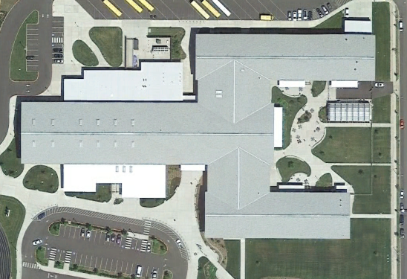
WHS Historical Look
Bond levy passed 2012
Construction began 2013
Construction ends 2015
First class 2015

Slide 48
WHS Statistics
Site 40.88 acres (2 parcels)
Building footprint approximately 2.64 acres (.97)
153,000 gross sqft
Original construction 2013/14
Parking – 414 car 10 ADA, 14 bus with auto shadow lines (46 auto)
614 students and 80 staff
Classrooms
18 Regular classrooms
6 Science labs
3 Computer /IT lab
1 Culinary
2 Business lab
1 Horticulture
1 Music room
2 Resource
1 Life Skills (currently SPED classroom)
1 Music room
1 Career center
2 Art rooms

Slide 49
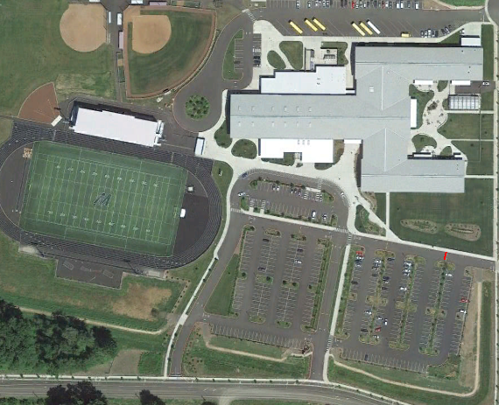
WHS Roof and Blacktop Map
A
B
5
2
6
Stadium
Locker room
Gym
Spin/weight Room
Classroom wing north
Classroom bridge north
Classroom bridge south
Classroom wing south
Entrance awnings (7 installations)
A North parking
B Sport fields and approaches
C Gym and exit rd.
D Main Parking west
E Main parking east
3
9
1
4
7
8
1
C
D
E
C

Slide 50
WHS
ROOFING ANALYSIS
Name /Area | Sqft. | Type | Grade (key below) | Remaining Life | Cost (NA if past 10 years) | Expect Life | Note
Stadium (1) | 11,700 | Metal | B | 87.5% | N/A | 30-50 year (40)
Locker Room (2) | 10,250 | Metal | B | 87.5% | N/A | 30-50 year (40)
Gym (3) | 49,675 | Composition | B | 83% | N/A | 30 year
Spin/Weight Room (4) | 7,000 | Metal | B | 87.5% | N/A | 30-50 year (40)
Classroom Wing North (5) | 26,426 | Composition | B | 83% | N/A | 30 year
Classroom Bridge North (6) | 5,720 | Composition | B | 83% | N/A | 30 year
Classroom Bridge South (7) | 6,435 | Composition | B | 83% | N/A | 30 year
Classroom wing South (8) | 21,450 | Composition | B | 83% | N/A | 30 year
Entrance Awnings (9) | 1,800 | Metal | B | 87.5% | N/A | 30-50 year (40)
A | New | B | Near new condition >75% | C | Mid life span >50% | D | Requires moderate >repairs 25% | F | Imminent failure, in need of replacement

Slide 51
WHS Blacktop Analysis
Name /Area | Sqft. | Current Type | Grade | Cost of Repair sqft. | Extended Cost | Note
North parking lot (A) | 89,785 | Blacktop | A | .36 | $32,322 | Sealcoat/stripe/repaired 2022/2026
Sports field and stadium approaches (B) service rds. | 40,500 | Blacktop | A | .36 | $14,580 | Sealcoat/stripe/repaired 2023/2028
Gym parking and exit road (C) | 82,500 | Blacktop | A | .36 | $29,700 | Sealcoat/stripe/repair 2022/2027
Main parking west and entrance rd. (D) | 62,000 | Blacktop | A | .36 | $22,320 | Sealcoat/stripe/repair 2021/2026/2031
Main parking east (E) | 64,980 | Blacktop | A | .36 | $23,392 | Sealcoat/stripe/repair 2022/2027

Slide 52
WHS Flooring
All Flooring >10 years

Slide 53
WHS HVAC
Two Fulton high efficiency boilers
Multiple HW/CW air handlers
Multiple MAU with heat recovery
No major maintenance expected within 10 years other than routine preventive maintenance and inspections

Slide 54
WHS Structural and Exterior
Built to seismic design category D (high seismic vulnerability)
No structural cost expected within 10 years
Seismic Design Category (SDC) | Definition
A | Very small seismic vulnerability
B | Low to moderate seismic vulnerability
C | Moderate seismic vulnerability
D | High seismic vulnerability
E&F | Very high seismic vulnerability and near major fault

Slide 55
WHS Utilities
Electrical
12.5KW solar facility install in 2021 for $10K
Fire Safety
Fully sprinklered interior wet system, exterior dry system

Slide 56
WHS Grounds
Install well storage and distribution system for $45K
Apply for water rights

Slide 57
WHS 120 Month Plan
6 month | 2021 | 2022 | 2023 | 2024 | 2025 | 2026 | 2027 | 2028 | 2029 | 2030 | 2031
Blacktop | - |  | $32,322 | $46,118 | $29,700 | $14,580 | - |  |  | $32,322 | $46,118
Roof | - | - | - | - | - | - | - | - | -
Flooring | - | - | - | - | - | - | - | - | -
HVAC | - | - | - | - | - | - | - | - | -
Structural/Ext | - | - | - | - | - | - | - | - | -
Utilities | $10,000 | $6,000 | - | - | - | - | - | - | -
Grounds | - | $45,000 | - | - | - | - | - | - | -
Portables | - | - | - | - | - | - | - | - | -
Total WHS | $10,000 | $51,000 | $32,322 | $46,118 | $29,700 | $14,580 |  |  |  | $32,322 | $46,118

Slide 58
Yale School
Home of the Cougars

Slide 59
Yale School Historical Look
House
Old school Location
Demolished
Current School Building
Constructed 1962
Cafeteria
and Library
Addition 1993
Gym Complete
Restoration 2014

Slide 60
Yale School School Statistics
Site 8.94 acres (2 parcels)
Building area .33 acres (school .25, gym .08)
Original construction 1962
Addition 1993 adds library, cafeteria and hallway
Total sqft. 14,975 (school 11,000, gym 3,975)
3c lassrooms
Library
Cafeteria
Gravel parking lot. Estimated @ 30 spaces
6 staff and 45 students

Slide 61
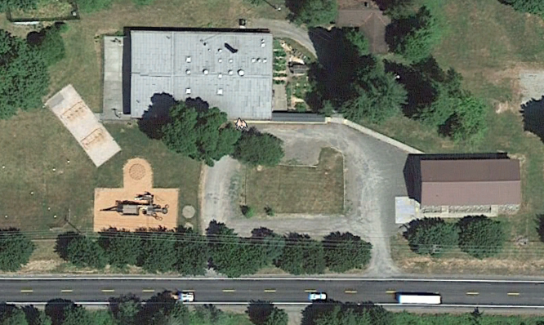
Yale School Blacktop and Roof Plan
1
Roof
1 Main school building
2 Gym roof
Blacktop (gravel)
A Gravel only
A
2

Slide 62
Yale School Roof Plan & Blacktop Plan
Name /Area | Sq. ft. | Type | Grade (key below) | Remaining Life | Cost (NA if past 10 years) | Expected Life | Note
School (1) | 10960 | Comp cap Built-up | D | 5% | $24,750 | 25 year | May be candidate for coating
Gym (2) | 3800 | Metal | A | 87.5% |  | 30-50 year(40)
Name /Area | Sq. ft. | Current Type | Grade | Cost of Repair sq. ft. | Extended Cost | Note
Parking area (A) | 23,250 | Gravel | N/A | .15 | $2000 | Re-gravel annual

Slide 63
Yale School Flooring
Area | Material | Condition | Notes
Kitchen | VCT tile | C $7,500-2027 | Tile and adhesive possible source of asbestos
Entry and main hall | Carpet over VCT | C $5,000-2026 | Asbestos risk
Classroom 1 | Carpet over VCT | B $5,000-2028 | Asbestos risk
Classroom 2 | Carpet over VCT | B $5,000-2028 | Asbestos risk
Classroom 3 | Carpet over VCT | B $5,000-2028 | Asbestos risk
Library | Carpet | B $5,000-2029
Cafeteria | Tile | B $5,000-2029

Slide 64
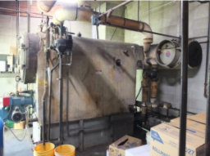
Yale School HVAC
Currently heated by 57 year old, oil fired steam boiler
Library and cafeteria are heated by 2 small oil forced-air furnaces
Environmental concerns regarding buried heating oil tank

Slide 65
Yale School Utilities
Water
Well system and storage tank
Interior piping galvanized steel
Chlorination system installed in 2020
Add drinking water service line in 2021 for $5,000
Electrical
Main switchboard cleaning and maintenance in 2022 for $2,500
Propane
Heating for gym area
Install gas leak detection and auto shutoff in 2023 for $2,500
Fire Safety
No sprinklers. Install fire pump and distribution for $50K (seek grant $$)

Slide 66
Yale School Grounds
Covered Walkway (120 lf) for $8,000
Add 120 lf of covered walkway to existing system
Structural and Exterior
No cost within 10 years

Slide 67
Yale School 120 Month Plan
 | 2021 | 2022 | 2023 | 2024 | 2025 | 2026 | 2027 | 2028 | 2029 | 2030 | 2031
Roof |  |  | $24,750
Blacktop/Gravel |  | $2,000 |  | $2,000 |  | $2,000 |  | $2,000 |  | $2,000
Flooring |  |  |  |  |  | $5,000 | $7500 | $15,000 | $10,000
HVAC
Structural /Exterior
Utilities | $5,000 | $5,000
Grounds |  | $8,000
Portables
Total Yale | $5,000 | $15,000 | $24,750 | $2,000 |  | $7,000 | $7,500 | $17,000 | $10,000 | $2,000

Slide 68
District Assets Equipment, Vehicles and Holdings
Partners In Transition (PIT) house
Team High and Business Office portables
Fleet Vehicles
Grounds Equipment
District Assets 10 year plan
Consolidated 10 year plan

Slide 69
Pit House 10 Year Plan
 | 2021 | 2022 | 2023 | 2024 | 2025 | 2026 | 2027 | 2028 | 2029 | 2030 | 2031
Roof 3 tab |  |  |  | 12,500
Siding LP |  |  | $12,500
Plumbing
Kitchen
Flooring
Grounds
Total |  |  | $12,500 | $12,500

Slide 70
Team and BO Portables Portable Plan
Port. Bldg. | Use | Roof | Siding | Ramp | Flooring | Int. Finish | Ext Paint | Rest Rooms | Cost/ Notes
Business Office | WCC | 3 Tab >10yr | A | Permanent Aluminum | Carpet | A | 2025 $1500 | Yes OK | Building in good material condition. Exterior painted in August 2018.
TEAM High | Alt HS | 3 Tab >10yr | A | Permanent Aluminum | Carpet | A | 2025 $1500 | Yes OK | Building in good material condition. Exterior painted in August 2018. New addition 2021.

Slide 71
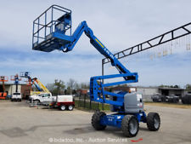
District Grounds Equipment
MFG | MDL | EQ TYPE | YEAR | LOCATION
John Deere | JDX 750 | Mower | 2015 | WMS | New for WHS
John Deere | JDX 748 | Mower | 2007 | WMS | >10 yr.
John Deere | 2032 | Tractor | 2015 | WMS | New for WHS
John Deere | JD 955 | Tractor | 1997 | WHS | >10 yr.
Kubota | ZG 222 | Mower | 2008 | WHS | >10 yr.
John Deere | JD 455 | Mower | 1995 | WIS | >10 yr.
John Deere | JD 455 | Mower | 1995 | Yale | >10 yr.
Walker |  | Mower | 2019 | WMS | New
Equipment Need | Model | Cost | Year
Exterior 45’ Lift | JLG or Genie DSL | $15,000 | Used

Slide 72
District Fleet Vehicle’s
Name | Year | Make | Model | Location/Use | Color | Mileage | Action | RPL | Cost
Grounds Truck | 1988 | Chevy | C-20 | Grounds | White | 165,033 | Sell
Grounds Truck | 1991 | Chevy | C-20 | Grounds | Red | 236,552 | Sell
HVAC Van | 2002 | Ford | Club Wagon | HVAC | White | 109,793
Tech Van | 1989 | Chevy | Sports van | Tech | Grey | 46,203 | Sell
White van | 1986 | Ford | Club Wagon | Maintenance | White | 66,899
White Van | 2012 | Ford | E-150 | Tech
Grey Truck | 2011 | Ford | F150 | Safety /Maint
Grounds 1 truck | 2006 | Chevy | Silverado | Maintenance | White | 112,711
Grounds 2 truck | 2015 | Ford | F150 | Grounds
Pit 2 | 2004 | Chrysler | T&C | Pit /BO | Silver | 136,494 |  | 2022
E11 | 2015 | Chevy | Express | WHS | White | 26,810 |  | 2026 | $28,000
E12 | 2015 | Chevy | Express | WHS | White | 23,153 |  | 2027 | $28,000
E13 | 2015 | Chevy | Express | WHS | White | 14,399 |  | 2028 | $28,000
Suburban | 2004 | Chevy | Suburban | WHS |  | 130,557 |  | 2021 | 15,000
Mini 1 | 2007 | Dodge | Caravan | WHS | Bl/Gr | 96,116
Mini 2 | 2006 | Dodge | Caravan | WHS | Lt Blue | 113426

Slide 73
District Summary 120 Month Plan
 | 2021 | 2022 | 2023 | 2024 | 2025 | 2026 | 2027 | 2028 | 2029 | 2030 | 2031
PIT house | - | - | $12,500 | $12,500 | - | - | - | - | - | - | -
TEAM and BO Portables | - | - | - | - | $3,000 | - | - | - | - | - | -
Grounds Equipment | - | - | - | - | $20,000 | $7,500 | - | - | - | - | -
Fleet Vehicles | $15,000 | $15,000 | - | - | - | $28,000 | $28,000 | $28,000 | - | - | -
Total | $15,000 | $15,000 | $12,500 | $12,500 | $23,000 | $35,500 | $28,000 | $28,000 | - | - | -

Slide 74
District Summary 120 Month Plan
 | 2021 | 2022 | 2023 | 2024 | 2025 | 2026 | 2027 | 2028 | 2029 | 2030 | 2031 | Total
CES | $42,740 | $58,912 | $37,960 | $83,605 | $17,000 | $38,000 | $6,000 | $54,802 | $17,700 | $3,960 |  | $360,679
NFES | $7,000 | $40,240 | $12,000 | $14,500 | $34,860 | $14,500 | $28,740 | $12,000 | $12,000 | $57,860 |  | $233,700
WMS | $112,657 | $67,540 | $75,500 | $85,980 | $62,481 | $85,150 | $113,575 | $84,137 | $40,540 | $89,112 | $61,880 | $878,552
WHS | $10,000 | $51,000 | $32,322 | $46,118 | $29,700 | $14,580 |  |  |  | $32,322 | $46,118 | $262,160
Yale | $5,000 | $15,000 | $24,750 | $2,000 | - | $7,000 | $7,500 | $17,000 | $10,000 | $2,000 |  | $95,250
District | $15,000 | $15,000 | $12,500 | $12,500 | $23,000 | $35,500 | $28,000 | $5,000 | $28,000 | $28,000 |  | $202,500
Annual Total | $192,392 | $247,692 | $195,032 | $244,703 | $167,041 | $194,730 | $183,815 | $172,939 | $108,240 | $213,254 | $107,998

